Slide 1
Texas Instruments Tracking Device Playbook
March 2024

Slide 2
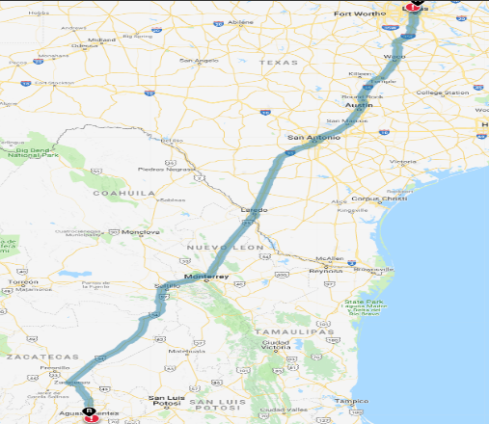
Introduction
Digital tracking devices provide real time visibility into TI shipments
  GPS location (within 50 feet)
  Shock (>15G)
  Temperature
  Humidity (>75%)
  Geofencing (defined per shipment)
  Light (package breach)
This visibility allows TI to better manage our supply chain and reduce risk.
TI began using digital tracking devices in 2016.
  Time and time again these devices have proven their worth by providing notifications that inevitably avoided material scrap and shipment damage.
TI currently requires tracking devices on all shipments of semiconductor manufacturing equipment with a value > $250K traveling a distance greater than 50KM.
  Value is determined as total shipment value.
    Example: Shipment of a single tool >$250K requires one tracking device
    Example: Combined shipment of three tools with individual values of $100K requires one tracking device.

Slide 3
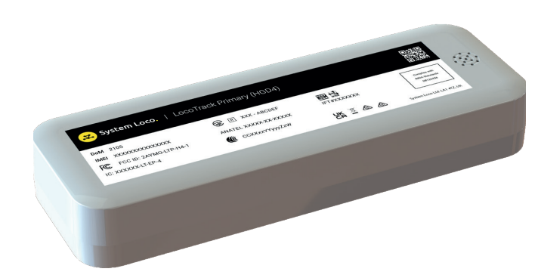

Introduction Cont
HGD4
Tracking devices are attached on the exterior of crates
  Having devices visible has driven better handling of our cargo
Automatic alerts are sent to subscribers and can be adjusted
  Parameters can be adjusted
  Notification frequency can be adjusted (standard is 15 min)
  Subscribers can be added at any time
    Single Sign On is being explored with TI IT
We use System Loco HGD4 which has an alkaline battery
In 2020 we began using tracking devices for precious metal reclaim shipments
Tracking devices may soon be used for high value raw material and semi-finished goods shipments
  Tracking devices have been used to monitor temperature on Mold Compound shipments since 2016
TI Capital Accounting is exploring the use of tracking devices on installed assets
Notes:
This is a test

Slide 4
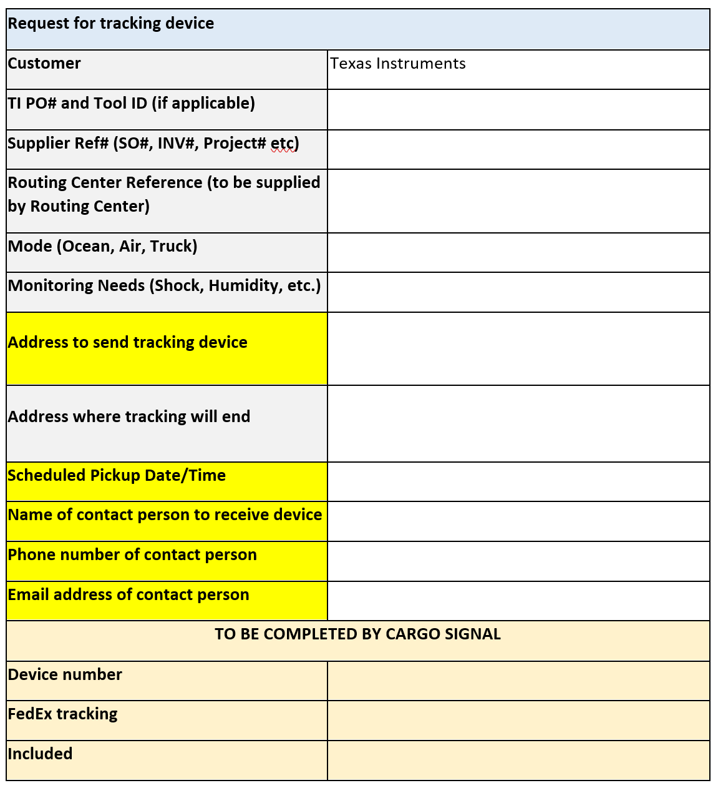
Process
Shipper contacts the TI Routing Center to book shipment:
    Email : texasinstruments@pegasuslogistics.com
    Phone: +1-800 854 3364
  In addition to providing booking instructions and shipping guidelines the TI Routing Center provides a Tracking Device Order Form.
    Fields in grey will be filled in by the TI Routing Center
    Fields in yellow must be completed by the Shipper
    Fields in tan will be filled in by TI’s tracking devices provider (Cargo Signal)
Shipper completes the form and emails it to commandcenter@cargosignal.com & texasinstruments@pegasuslogistics.com
  Tracking devices must be ordered a minimum of 10 days before shipping date.

Slide 5
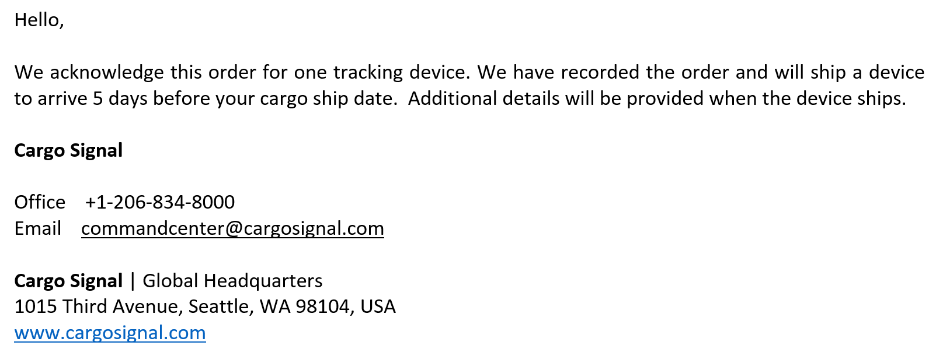
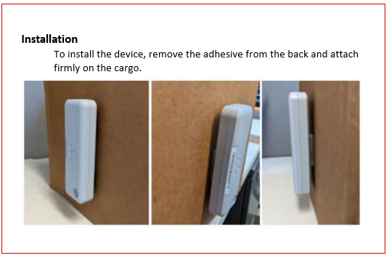
Process Cont.
Cargo Signal will send a reply email confirming order:
When device is shipped a second email will be sent by Cargo Signal:
  FedEx tracking information
  Device activation instructions
  Device installation instructions
  Shipments to China will also receive CIQ information
Tracking device will arrive 5 days prior to cargo shipment
  The above can only be achieved if the tracking device is ordered 10 days before cargo shipment
  HGD4 is a non-rechargeable battery operated device
Notes:
No longer including the compliance packet. Has not been an issue anymore.

Slide 6
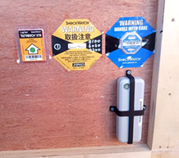
Process Cont.
Shipper attaches the tracking device using the bracket and screws provided
  Tracking device should be attached to the crate containing the tool main body
Shipper will contact commandcenter@cargosignal.com 24hrs before
shipment to conduct a device connection test
  Device HGD4 model (using alkaline battery) must push the button to activate before shipment
    The device is not rechargeable. Once activated, it cannot be shut down or deactivated.
  Connection test is to ensure communication link is optimal and that the device serial number is tied to that specific shipment
Shipper ensures shipping paperwork is in order
  Important notes:
    Most countries require some level of permitting/approval to use these devices
  TI and Cargo Signal have successfully used these devices on thousands of shipments across the globe.
    Any questions regarding permitting, declaration, etc. should be directed to commandcenter@cargosignal.com
    Cargo Signal has offices in Asia and US and provide support 24/7
      Common concerns: Airline approvals, China CIQ requirements
        Cargo Signal maintains a library of all documents and approvals needed to ensure smooth shipping.
    First time shippers have historically needed additional support from Cargo Signal and or TI however subsequent shipments have been very easy. Shippers are encouraged to leverage Cargo Signal’s expertise as much as they need to.

Slide 7
Process Cont.
TI’s freight forwarder picks up shipment
Shipment is delivered to TI destination (unloaded on TI dock)
TI receiving team removes tracking device from crate
The HDG4 model (which has an alkaline battery) is a disposable device and does not need to be returned to the Command Center

Slide 8
Bulk Shipping Process
For shippers with >10 shipments in a one month period devices can be ordered in bulk
Bulk orders must be approved by TI personnel
The ordering process remains the same however the bulk quantity must be specified
Upon attaching a device to a shipment, shipper must contact Cargo Signal and provide the TI PO number, SO and the device ID number it was attached to

Slide 9
Shipments to China
Shipping tracking devices into TI bonded zone in China requires additional effort
  As of 4Q20 devices must be declared with a “CIQ” form
  Devices must be declared as “equipment”
  Equipment must be classified as new or used
    Used devices require customs inspection
      Inspection adds 1-2 days to transit time
    New devices are inspected 6-8% of the time
  Lithium battery must be certified by the Shanghai Research Institute of Chemical Industry
Returning devices from TI must also follow a specific process
  Process has been developed by TICD team

Slide 10
Thank You

